Slide 1



OPTIMIZATION OF INDUCTOR-BASED DICKSON CHARGE PUMP FOR LOW-POWER APPLICATION
Presented by:
SK. AMEER BASHA - 21491A04K8
P. LAVANYA - 21491A04K6
G. TIRUMALA TEJA- 21491A0429
A. BHARGAV RAM - 21491A0455
K. RAMESH BABU -21491A04C4
P. VENKATA SIVA - 21491A0424
Under the Guidance of
MR.D CHAITNYA
Assistant professor
Department of Electronics and Communication Engineering

Slide 2

Outline
ABSTRACT
INTRODUCTION
LITERATURE REVIEW
OBJECTIVE
EXISTING METHOD
PROPOSED METHOD
HARDWARE & SOFTWARE INVOLVED
ADVANTAGES AND APPLICATION
SYSTEM DESIGN (Architecture)
REFERENCES
2

Slide 3
Abstract
A charge pump is an electronic circuit that increases voltage using switches, capacitors, and sometimes inductors. The Dickson charge pump is a well-known design, commonly used in low-power applications. However, traditional Dickson charge pumps rely only on capacitors, which can lead to power losses and lower efficiency. In this work, we propose an improved version that incorporates inductors to enhance performance. Inductors help store and transfer energy more efficiently, reducing power loss and improving voltage conversion. This makes the charge pump more suitable for low-power applications like energy harvesting, IoT devices, and biomedical electronics. Our optimization focuses on selecting the right inductor values, reducing switching losses, and improving control techniques. By carefully designing these aspects, we achieve higher efficiency and lower power consumption. Additionally, our design minimizes voltage ripple, ensuring stable output voltage. Simulations and experimental tests confirm that the proposed charge pump outperforms conventional designs. It provides better energy efficiency, making it ideal for battery-powered and energy-constrained systems. Compared to traditional charge pumps, our design achieves higher voltage gain with reduced power loss. This improvement is crucial for applications where power efficiency is a priority.
3

Slide 4
Introduction
Electronic devices often require a higher voltage than their power source provides. A charge pump is a special circuit that increases voltage using switches, capacitors, and sometimes inductors. The Dickson charge pump is a well-known type that traditionally uses capacitors to store and transfer energy. To improve efficiency, we introduce an optimized Dickson charge pump that incorporates inductors. Inductors help store energy more effectively and reduce power loss during the voltage conversion process. This makes the charge pump more suitable for applications that require minimal power consumption, such as energy harvesting, medical devices, and IoT systems. A well-designed charge pump can provide the necessary voltage without wasting energy. Our work focuses on optimizing the circuit by selecting the best inductors, reducing switching losses, and improving the control mechanism. These improvements help the charge pump deliver a stable voltage output while consuming less power. Unlike traditional capacitor-based charge pumps, our design provides better energy efficiency and reduces voltage ripple. This makes it ideal for battery-powered and energy- constrained applications. By carefully designing the circuit, we achieve higher voltage gain with minimal power loss. The optimized charge pump can be used in tiny sensors, wearable electronics, and implanted medical devices. Efficient power conversion is crucial for modern electronics, where energy efficiency is a top priority.
4

Slide 5
Literature Survey
Ref. No | Title & Author | Technique Used | Pros | Cons
1 | Charge Pumps for Ultra-Low-Power Applications “Andrea Ballo, Student Member, IEEE ” | Voltage-doubling, optimization | Low Power Consumption: | Limited Output Power
2 | Long-lived charge separation following pump-wavelength–dependent ultrafast “Shuai Fu , Indy du Fossé” | Wavelength- Dependent Excitation | Enhanced Charge Separation | Material Dependence
3 | Exploring 4D Quantum Hall Physics with a 2D Topological Charge Pump”” | Quantum Hall Effect in Lower Dimensions | Topological Protection | Complexity in Realization
4 | Regulated Charge Pumps: A Comparative Study by Means of Verilog-AMS” Andrea Ballo , Michele Bottaro” | Charge Pump Design Variants | Simulation Flexibility | Modeling Limitations
5 | MOS Charge Pumps for Low-Voltage Operation” Jieh-Tsorng Wu, Member, IEEE” | Voltage Doubling and Boosting | Reduced Power Consumption | Limited Output Power
5
Monday, December 23, 20
24

Slide 6
Literature Survey
Ref. No | Title & Author | Technique Used | Pros | Cons
6 | Aamna anil and ravi kumar sharma | Switched- Capacitor Charge Pump | High efficiency and low voltage operation | Higher Design Time
7 | Woogeun Rhee | Current-Mode Logic (CML) Charge Pump | High speed operation | Potential for Oscillations
8 | Dr. B. Venkata Prasantha | Microcontroller -based Control | Improved Safety | Limited Range
9 | Woogeun Rhee | Switched-Capacitor Charge Pump with Zero-Voltage Switching (ZVS) | Easy Integration | Limited Flexibility
10 | : Andrea Ballo, Alfio Dario Grasso, and Gaetano Palumbo | Hybrid Charge Pump | Reduced Heat Generation | Complexity
6
Monday, December 23, 2
024

Slide 7
Motivation
1.Increasing Efficiency:
* Reduced Power Loss:
charge pumps, when optimized, can achieve higher efficiency compared to traditional capacitor-based Dickson charge pumps, especially at higher output currents. This is because inductors can store and transfer energy more efficiently, minimizing resistive losses
Optimization aims to maximize the voltage conversion ratio, ensuring that the desired output voltage is achieved with minimal input power. This is crucial for applications where the input voltage is low, and a higher output voltage is required
2. Lowering Power Consumption:
* Minimizing Switching Losses: Optimizing the switching frequency and duty cycle reduces switching losses in the transistors and inductors.
* Reducing Leakage Currents: Careful selection of transistors and optimization of the circuit layout minimize leakage currents, which contribute significantly to power consumption, especially in low-power applications.
3. Enhancing Performance in Low-Power Applications:
* Battery-Powered Devices: Many portable and wearable devices rely on batteries, making low power consumption a critical requirement. Optimized inductor-based Dickson charge pumps can extend battery life by minimizing power losses
1.
2.
7

Slide 8
Objective
1. Efficiency Maximization :
Minimize conduction losses in switches and diodes. Reduce switching losses by optimizing switching frequency. Improve inductor quality factor (Q-factor) to reduce resistive losses.
2. Low Power Consumption:
Reduce gate drive losses in switching transistors. Optimize control logic for minimal dynamic power consumption. Choose low-power components (e.g., low-threshold MOSFETs).
3.To minimize power consumption:
This focuses on reducing the current drawn by the charge pump, particularly in stand by or idle modes, to
extend battery life or reduce energy requirements.
8

Slide 9
Existing Method
A high voltage charge pump design is being presented in this paper. The design is based on Dickson charge pump, constructed with diodes by using AMS 90nm technology. The innovation is made in Dickson charge pump i.e. charge control PMOS transistor is used in each stage of charge pump. PMOS transistor is used in series with charging capacitor which reduces the power consumption during the clock transition by controlling the time constant of each stage. The resistance between drain to source of PMOS transistor increases the time constant during the charging of the capacitor placed in each stage of charge pump. The output voltage of about 5.693V is achieved by the six stages of Dickson charge pump at no-load which reduces to 5.537V with the six stages of proposed charge pump but the power during the input clock transition is reduced from 340.5w (consumed by Dickson charge pump) to 28.85 W (consumed by the proposed modified charge pump). Some other results are also discussed in this paper, which are achieved on different load resistances.
9

Slide 10
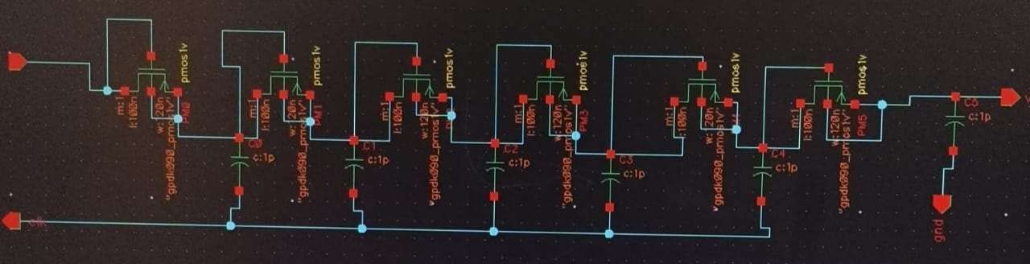
SCHEMATIC FOR DICKSON CHARGE PUMP
FIG : SCHEMATIC OF DIODE BASED DICKSON CHARGE PUMP FOR 90NM TECHNOLOGY

Slide 11
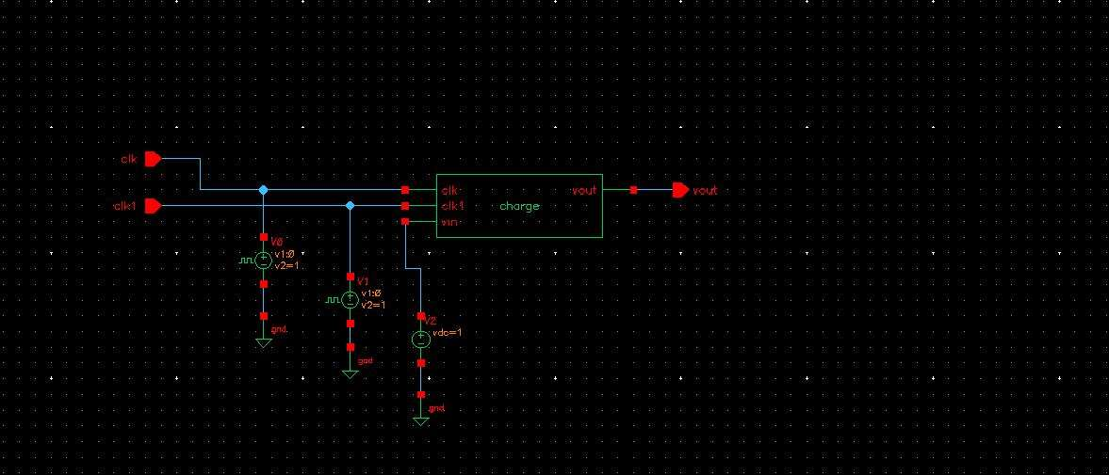

Slide 12
Proposed Method
The inductor-based Dickson charge pump operates by utilizing inductors, MOSFET switches, and capacitors to efficiently transfer and boost voltage in multiple stages. Initially, the circuit is powered by VDD, which provides the input voltage. The MOSFETs function as controlled switches, enabling the inductors to store energy when turned ON. Once the MOSFETs turn OFF, the inductors release the stored energy, transferring it to the next stage through capacitors. This sequential process continues across multiple stages, progressively increasing the voltage step by step.Each stage consists of inductors, capacitors, and switching transistors, working together to ensure proper charge transfer and energy conversion. The capacitors act as charge storage elements, reducing voltage ripple and stabilizing the output. The final stage generates an output voltage (VOUT) that is significantly higher than the input voltage, depending on the number of charge pump stages. The circuit's efficiency is influenced by factors such as switching frequency, inductor selection, and MOSFET conduction losses. Proper design optimization, including low-
12
loss components and an efficient control mechanism, ensures stable voltage regulation and

Slide 13
Explanation of Proposed Work
The optimization of an inductor-based Dickson charge pump for low-power applications involves multiple design enhancements to improve efficiency and minimize power losses. Firstly, selecting a high-Q inductor is crucial to reduce resistive losses, and using on-chip spiral or bond-wire inductors enhances integration. Switching strategy optimization plays a vital role, where techniques like zero-voltage switching (ZVS) and zero-current switching (ZCS) help reduce switching losses. Additionally, replacing diodes with MOSFET- based synchronous rectifiers lowers conduction losses. Proper transistor sizing, particularly optimizing the width-to-length (W/L) ratio and using low-threshold voltage (Vth) transistors, ensures efficient charge transfer with minimal losses. The clocking scheme can be improved by implementing adaptive frequency control to adjust the pump’s performance based on load conditions, along with non-overlapping clock phases to prevent charge sharing losses. Capacitor selection is another critical factor; high-density capacitors improve charge storage efficiency while optimizing their values helps minimize voltage ripple and enhance charge transfer.

Slide 14
Explanation of Proposed Work
Furthermore, reducing parasitic effects, such as capacitance and resistance in the layout, contributes to
overall efficiency, and shielding techniques can be employed to mitigate electromagnetic interference (EMI). Lastly, adaptive biasing circuits and feedback regulation mechanisms dynamically adjust power consumption and maintain a stable output voltage, ensuring optimal performance for low-power applications. By integrating these techniques, the inductor-based Dickson charge pump can achieve higher efficiency, reduced power dissipation, and enhanced performance in energy- constrained applications.

Slide 15
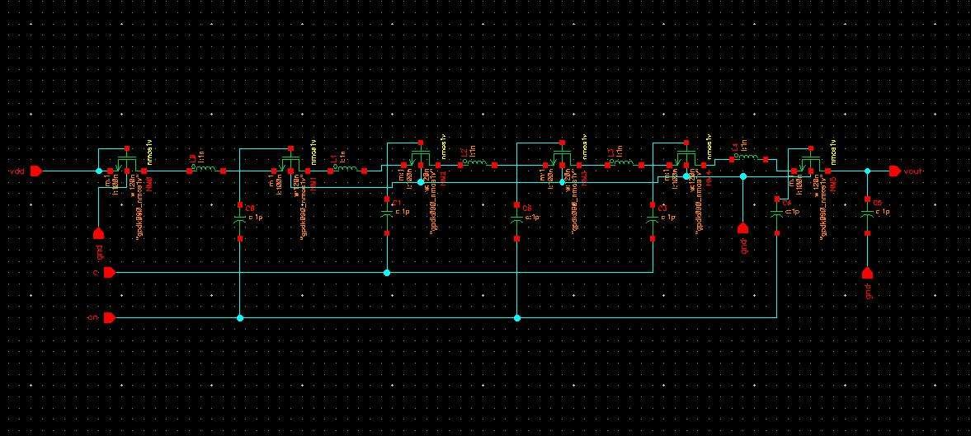
System Architecture/Proposed work Block diagram
Schematic for optimization of inductor-based Dickson charge pump for low- power applications
18

Slide 16
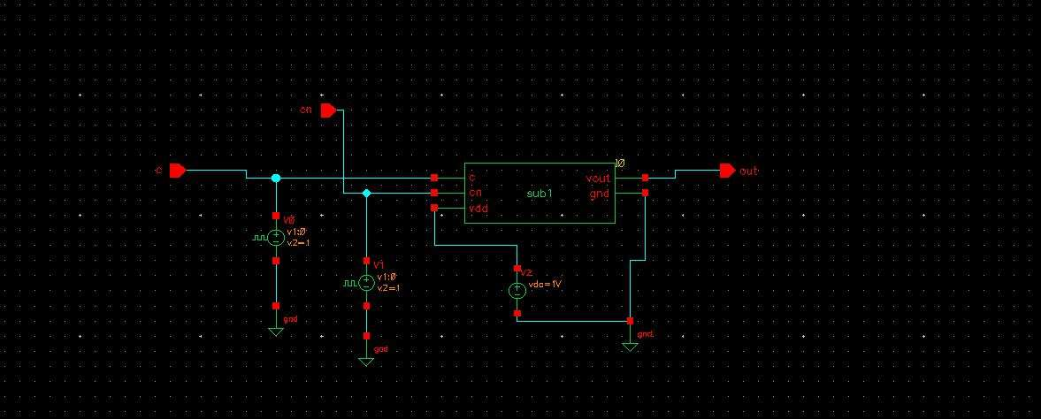
Symbol for optimization of inductor-based Dickson charge pump for low- power applications
19

Slide 17
Hardware & Software Involved
Hard ware-NIL
Soft ware-cadence virtuoso tool

Slide 18
Application & Advantages
Applications:
1. Wireless Communication Systems: Advanced charge pump design enables PLLs to operate at higher frequencies, supporting faster data rates and improved wireless communication.
2. High-Speed Data Converters: Improved PLL stability reduces jitter and phase noise, enabling high-speed data converters to operate with higher accuracy.
Advantages:
1. Improved PLL Stability: Advanced charge pump design reduces phase noise and improves PLL stability, enabling systems to operate with higher accuracy.
2. Increased Frequency Range: Improved charge pump design enables PLLs to operate at higher frequencies, supporting faster data rates and improved system performance.
3. Reduced Jitter and Phase Noise: Advanced charge pump design minimizes jitter and phase noise, enabling systems to operate with higher precision.

Slide 19
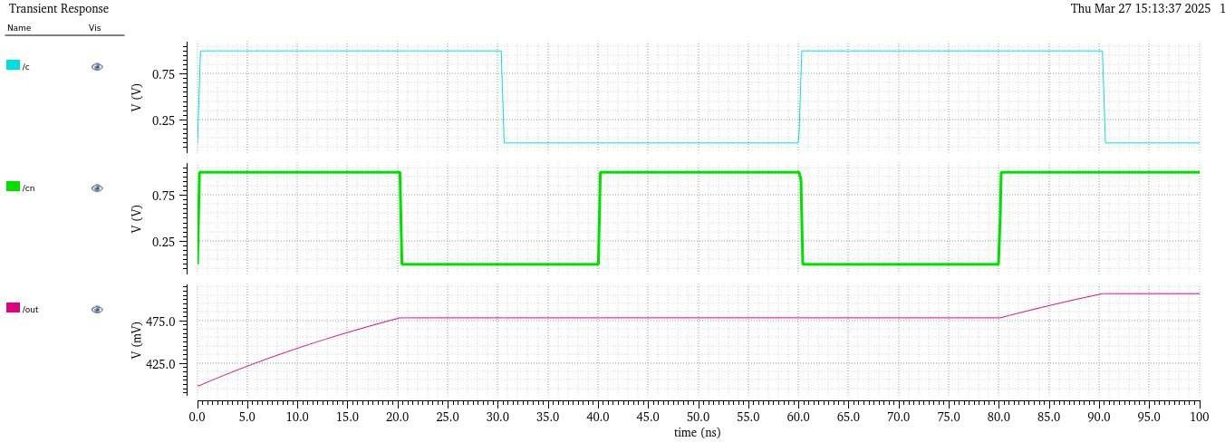
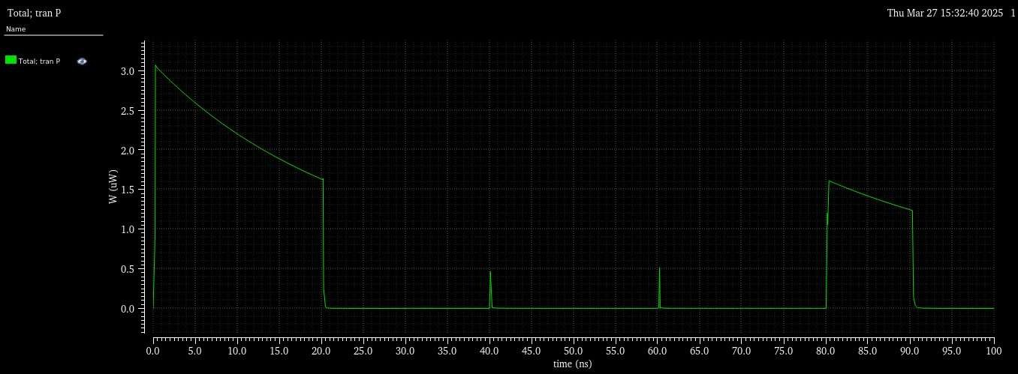
RESULTS

Slide 20
References (APA Style)
.A. Wang and A. Chandrakasan, “A 180-mV subthreshold FFT proces sor using a minimum energy design methodology,” IEEE J. Solid-State Circuits, vol. 40, no. 1, pp. 310–319, Jan. 2005.
S.-C. Luo and L.-Y. Chiou, “Asub-200-mV voltage-scalable SRAM with tolerance of access failure by self-activated bitline sensing,” IEEE Trans. Circuits Syst. II, Exp. Briefs, vol. 57, no. 6, pp. 440–445, Jun. 2010.
G. Bassi, L. Colalongo, A. Richelli, and Z. M. Kovacs-Vajna, “100 mV 1.2 V fully-integrated DC–DC converters for thermal energy harvesting,” IET Power Electron., vol. 6, no. 6, pp. 1151–1156, Jul. 2013.
P. Malcovati, F. Maloberti, C. Fiocchi, and M. Pruzzi, “Curvature com pensated BiCMOSbandgapwith1-Vsupplyvoltage,” IEEE J. Solid-State Circuits, vol. 36, no. 7, pp. 1076–1081, Jul. 2001.
J. Doyle, Y. J. Lee, Y.-B. Kim, H. Wilsch, and F. Lombardi, “ACMOS subbandgap reference circuit with 1-V power supply voltage,” IEEE J. Solid-State Circuits, vol. 39, no. 1, pp. 252–255, Jan. 2004.
V. Ivanov, R. Brederlow, and J. Gerber, “An ultra low power bandgap operational at supply from 0.75 V,” IEEE J. Solid-State Circuits, vol. 47, no. 7, pp. 1515–1523, Jul. 2012.
Y. Yang, D. M. Binkley, L. Li, C. Gu, and C. Li, “All-CMOS subbandgap reference circuit operating at low supply voltage,” in Proc. IEEE ISCAS, 2011, pp. 893–896.
G. Giustolisi, G. Palumbo, M. Criscione, and F. Cutrl, “A low-voltage low-power voltage reference based on subthreshold MOSFETs,” IEEE J. Solid-State Circuits, vol. 38, no. 1, pp. 151–154, Jan. 2003.
P. Kinget, C. Vezyrtzis, E. Chiang, B. Hung, and T. L. Li, “Voltage references for ultra-low supply voltages,” in Proc. IEEE Custom Integr. Circuits Conf., 2008, pp. 715–720.
L. Magnelli, F. Crupi, P. Corsonello, C. Pace, and G. Iannaccone, “A 2.6 nW, 0.45 V temperature-compensated subthreshold CMOS vol tage reference,” IEEE J. Solid-State Circuits, vol. 46, no. 2, pp. 465–474, Feb. 2011

Slide 21
THANK YOU

